Slide 1
Flyzy Flight Data Analysis
Using Microsoft Power Business Intelligent Tool:
Created By:
SATENDRA SHRIVASTAVA

Slide 2


INTRODUCTION:
Flyzy is one-of-a-kind travel-tech platform that aims to transform modern-day travel into a completely hassle-free experience by bringing innovation and power of technology right to your fingertips, quite literally! It connects retailers, service providers, and other stakeholders facilitating air, road, and train travel with the passengers via its unique hi-tech AI-enabled platform.
Apart from creating safer, simpler, and more personalised experiences for the passengers, Flyzy also ensures commercial benefits for the service providers and stakeholders involved. Flyzy's services will soon be made available for other popular modes of travel like rail and road.
http://www.flyzygo.com

Slide 3
BUSINESS OBJECTIVES:
The aviation industry is highly competitive, and airlines are always looking for ways to improve their operations and gain a competitive edge.
By analysing and visualising flight data using Power BI, airlines can gain insights into their performance and identify areas for improvement.
These insights can help airlines improve operational efficiency, enhance passenger satisfaction, increase revenue.
http://www.flyzygo.com

Slide 4
LEARNING GOALS:
Develop proficiency in data analysis and visualization using Power BI.
Learn to work with large and complex datasets from the aviation industry.
Develop skills in data cleaning, transformation, and manipulation.
Learn to identify patterns and trends in flight data, and derive insights to improve airline operations.

Slide 5
PROJECT HAS DONE IN THREE PARTS:
Flyzy: flight data analysis project has been done in three parts. Each part has some specific steps which has been performed accordingly. All part’s steps are explained below:
Steps To Perform Data Analysis:
1
Connecting to Data Source And Cleaning data
In this data analysis project, we started by checking for missing values in the data and handled them appropriately.
This is important because missing values can affect the accuracy and reliability of our analysis. We used appropriate methods such as dropping not useful columns.
2
Exploratory data Analysis (EDA)
Visualize the distribution of flight ticket prices.
Identify patterns, trends, and relationships between variables such as location of boarding, flight duration, and number of stops.
Use descriptive statistics to summarize the data.
Validate assumptions and detect outliers and other anomalies in the data
3
Data Insights And Visualization
Create interactive dashboards and visualizations to present the results of the exploratory data analysis
Highlight key insights and trends in the data such as the relationship between flight ticket price and flight duration
Use histograms, scatter plots, and box plots to display the distribution of the data and identify patterns and trends
Use interactive filters to allow the users to explore the data and discover insights

Slide 6
CONNECTING TO DATA SOURCE AND CLEANING DATA
1
The first step in this project is to clean and prepare the flight ticket price dataset.
This step is crucial for ensuring the accuracy and reliability of the results. It involves checking for missing values, transforming and aggregating the data, and verifying its quality and integrity.
The goal is to have a clean and well-structured dataset that is ready for further analysis.
Load the flight ticket price dataset into Power BI
Check for missing values and handle them appropriately
Transform and aggregate the data as needed for further analysis
Verify the data quality and integrity.
In this data analysis project, we started by checking for missing values in the data and handled them appropriately.
This is important because missing values can affect the accuracy and reliability of our analysis. We used appropriate methods such as dropping not useful columns.

Slide 7
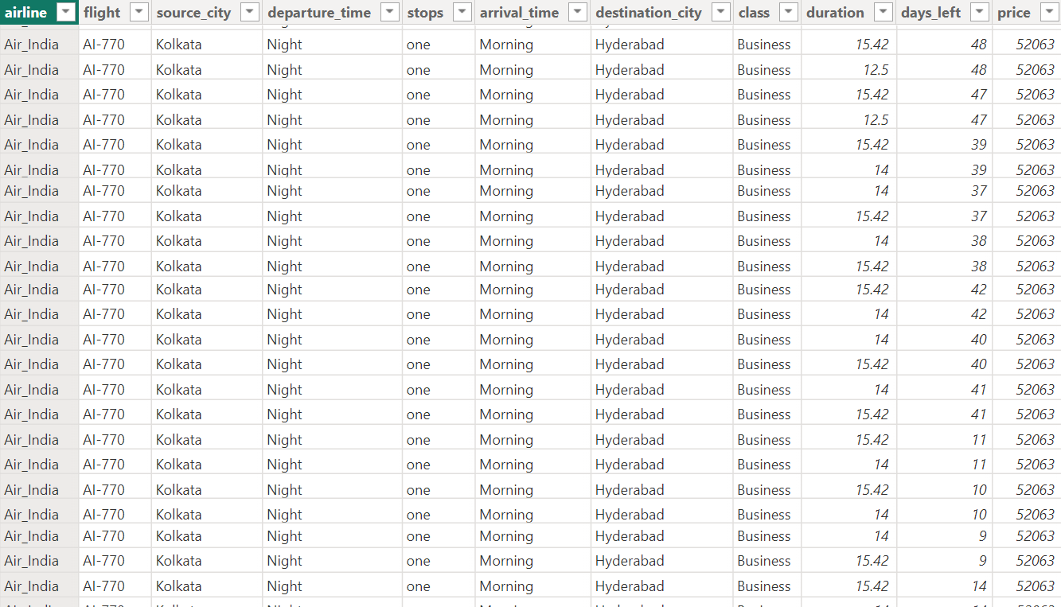
SAMPAL DATA AFTER CLEANING:
Finally, we verified the data quality and integrity to ensure the data was reliable and accurate, and loaded in power bi for further analysis.

Slide 8
EXPLORATORY DATA ANALYSIS (EDA)
2
The second step is to perform an exploratory data analysis of the flight ticket price dataset.
This task involves visualizing the data, identifying patterns, trends, and relationships between variables, and using descriptive statistics to summarize the data.
The goal is to gain a deeper understanding of the data and to validate assumptions, detect outliers and other anomalies, and uncover interesting insights.
In this step I have,
Visualize the distribution of flight ticket prices.
Identify patterns, trends, and relationships between variables such as location of boarding, flight duration, and number of stops.
Use descriptive statistics to summarize the data.
Validate assumptions and detect outliers and other anomalies in the data

Slide 9
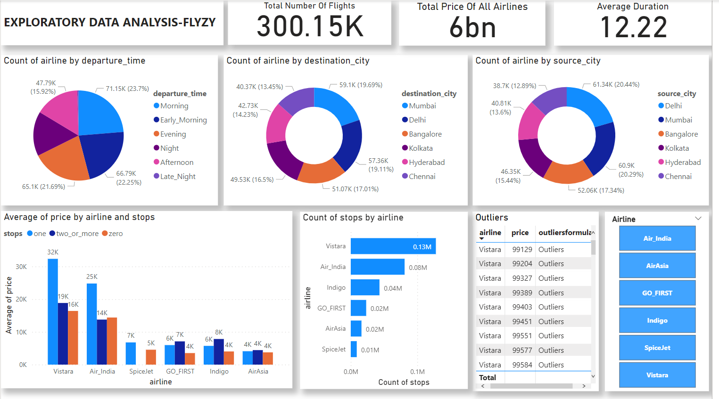
FINAL EDA REPRESENTATION
2

Slide 10
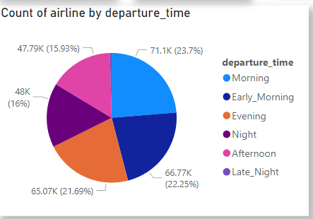
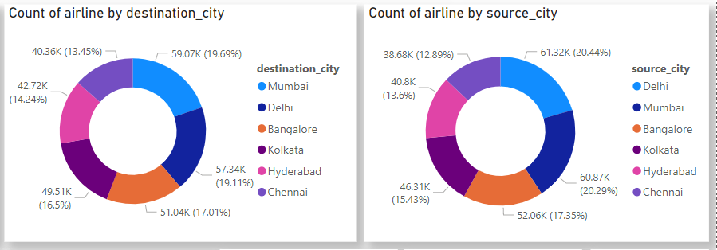
INSIGHTS VISUALIZATION
1- Most of the flights (23.7%) are departing in the morning.
2- The majority of flights are going to Mumbai from Delhi in the Morning.

Slide 11
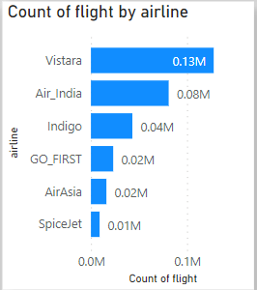
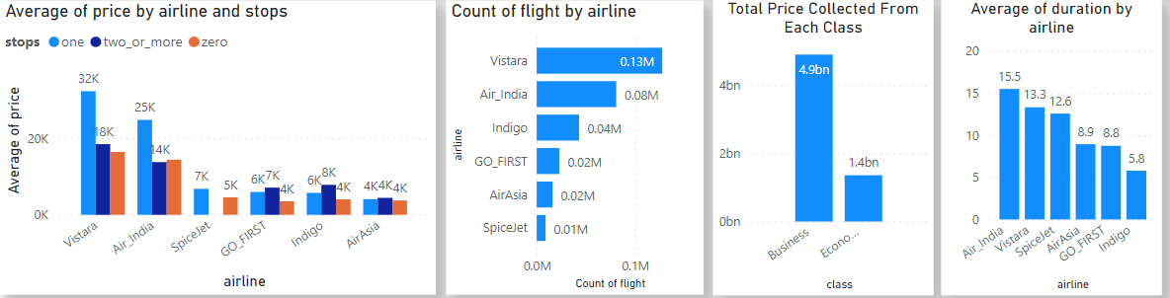
INSIGHTS VISUALIZATION
3- Highest and lowest number of Flights by airlines. Vistara has highest number of Flights: 0.13M SpiceJet has lowest number of Flights: 0.01M
2- Some other insights are here.

Slide 12
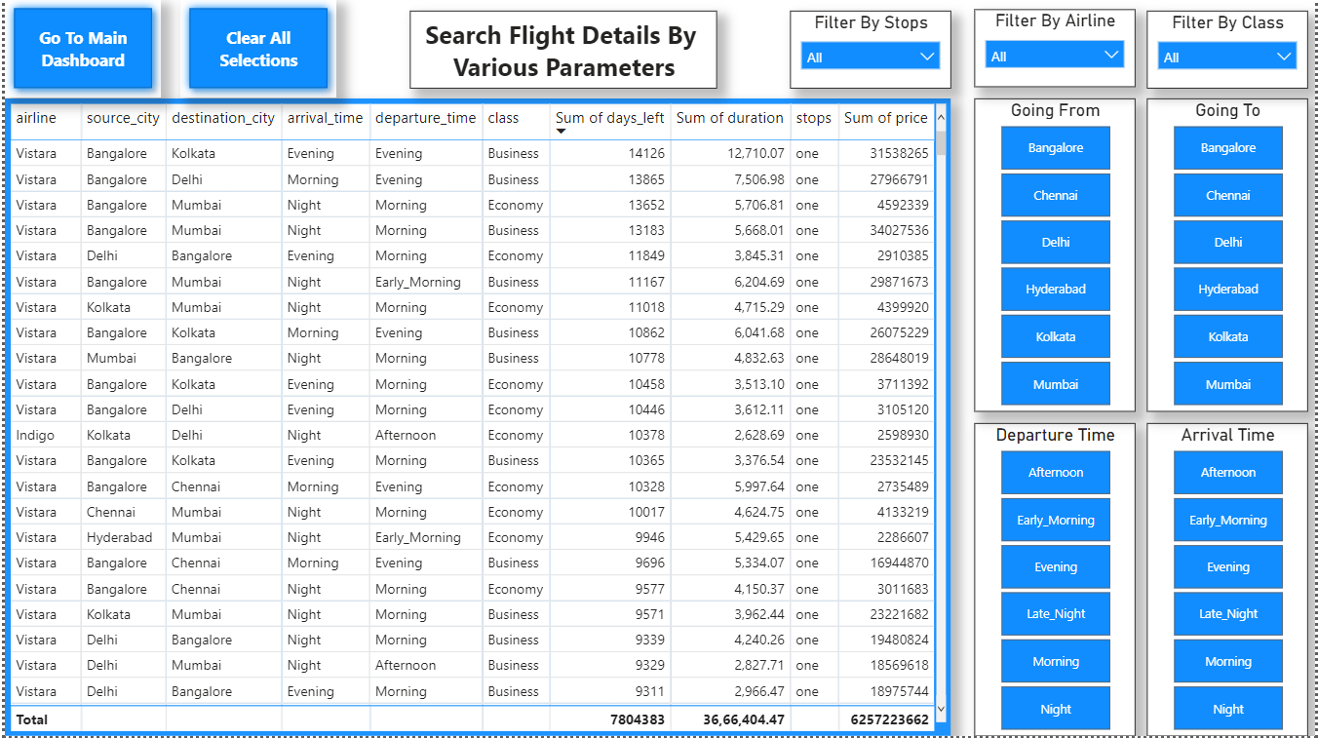
DETAILED SEARCH VARIOUS PARAMETER, SECTION:

Slide 13
3
DATA INSIGHTS AND VISUALIZATION
The third step is to create interactive dashboards and visualizations to present the results of the exploratory data analysis.
In this step, I have created a final Dashboard using the Power BI tool.
Here are some useful insights which can be easily accessed through the Power BI report.
1- Most of the flights (23.7%) are departing in the morning.
2- The majority of flights are going to Mumbai from Delhi in the Morning.
3- The total number of flights is 300.03K.
4- Total price collected is 6 Billion.

Slide 14
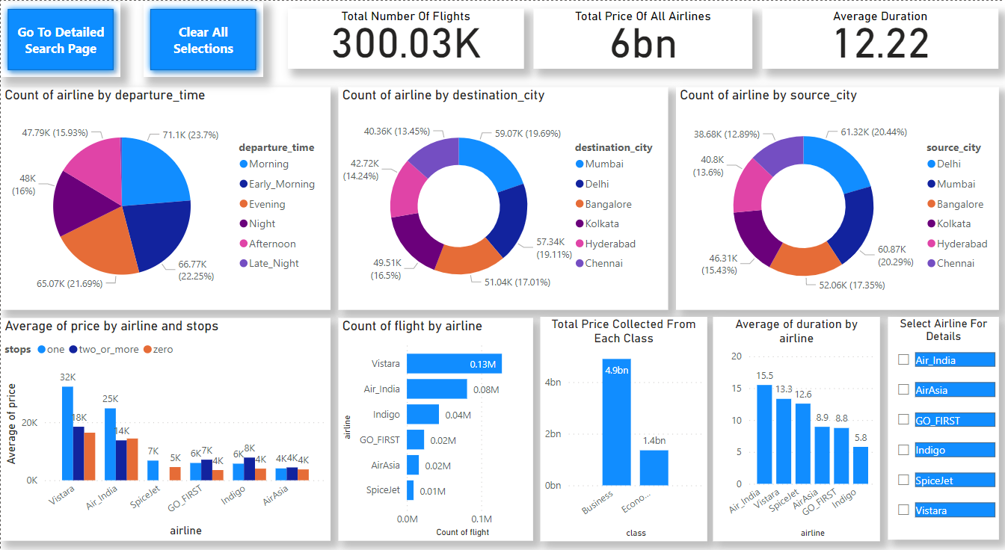
3
FINAL DASHBOARD

Slide 15
CONCLUSION:
Examining the factors that influence the cost of airline tickets is essential for airlines to maintain competitiveness within the market.
By comprehending the impact of various elements such as flight duration, days remaining until departure, arrival and departure times, competition, seasonality, ancillary fees, as well as supply and demand on ticket prices, airlines can make well-informed choices regarding pricing strategies.
This enables them to attract customers effectively and maximize revenue. The valuable insights obtained from data analysis assist airlines in formulating pricing approaches that are specifically tailored to their unique market conditions. Consequently, this can result in enhanced profitability and customer satisfaction. By harnessing the power of data, airlines can stay ahead of the competition and deliver optimal value to their esteemed customers.

Slide 16


